Slide 1








When Skies Not the Limit @ Space Y
Tijo John
12 April 2024

Slide 2
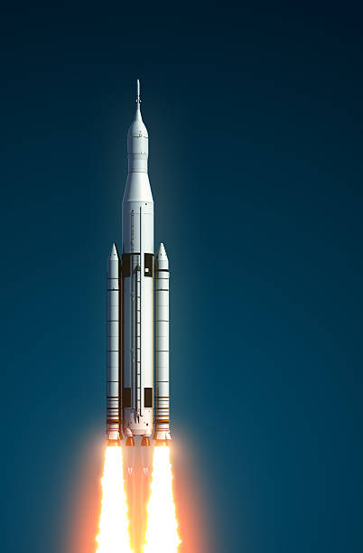


OUTLINE
Executive Summary
Introduction
Methodology
Results
Visualization – Charts
Dashboard
Discussion
Findings & Implications
Conclusion
Appendix

Slide 3

EXECUTIVE SUMMARY
Summary of Methodologies
- Space Y Data Collection using Space Y API
- Space Y Data Collection with Web Scraping
- Space Y Data Wrangling
- Space y Exploratory Data Analysis using SQL
- Space Y EDA DataViz using Python – Pandas & Matplotlib
- Space Y launch Site Analysis - Folium Interactive Visual Analytics & Plotly Dash
- Space Y Machine Learning Landing Prediction
Summary of all Results
- EDA Results
- Interactive Visual Analytics & Dashboards
- Predictive Analysis - Classification

Slide 4
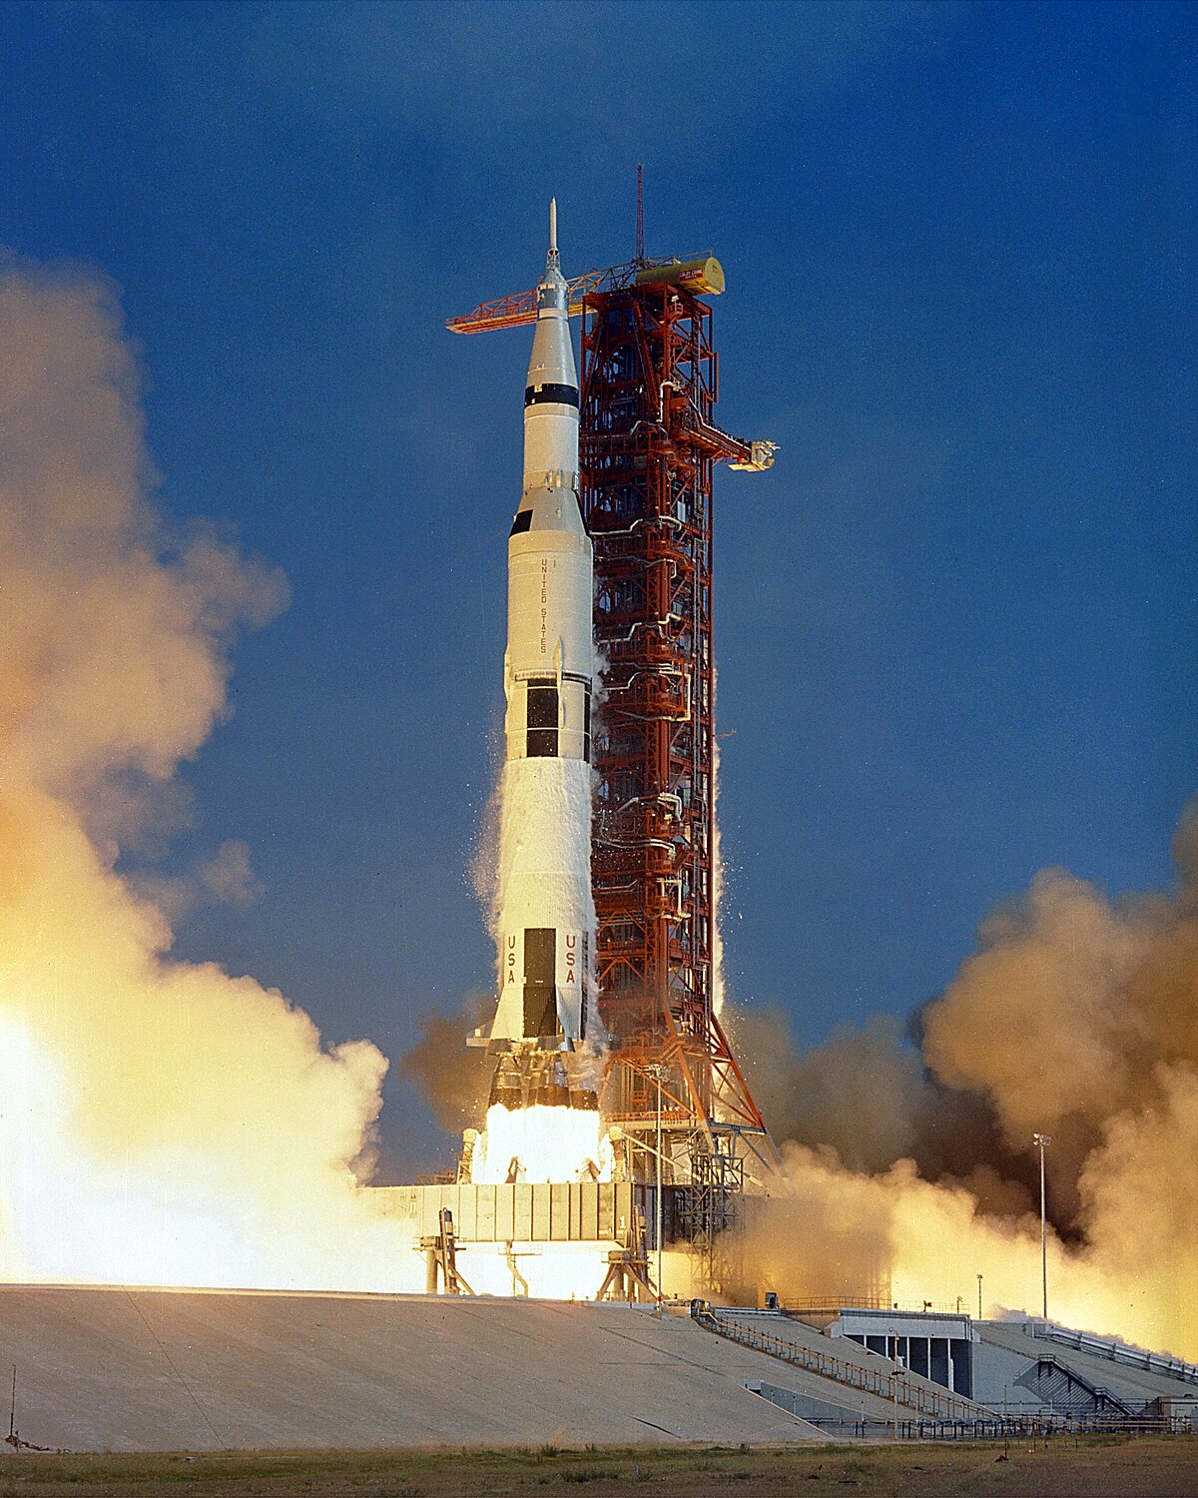
INTRODUCTION
Project Background and Context:
Space Y advertises Falcon 9 rocket launches with a cost of 62 million dollars while other providers cost upward of 165 million dollars each, much of the savings is because SpaceX can reuse the first stage.
Therefore if we can determine if the first stage will land, we can determine the cost of a launch.
This information can be used if an alternate company wants to bid against SpaceX for a rocket launch.
Desired Results:
We will predict if the Falcon 9 first stage will land successfully

Slide 5
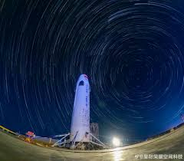
Section 1: METHODOLOGY
Data Collection Methodology
Perform Data Wrangling
Perform Exploratory Data Analysis – Visualization & SQL
Perform Interactive Visual Analytics – Folium & Plotly Dash
Perform Predictive Analysis – Classification models

Slide 6
Data Collection – Space Y API
Data collected using Space Y API by making a GET request, then parsed the launch data and decoded the response content as a JSON result which was then converted into Pandas data frame.
Completed GITHUB URL notebook: https://github.com/TiJohnMath/SpaceX-Falcon-9-first-stage-Landing-Prediction/tree/main

Slide 7
Data Collection – Web Scraping
Performed Web scraping to collect Falcon 9 records from Wikipedia using BeautifulSoup and Request and then created a data frame by parsing the launch HTML.
Completed GITHUB URL notebook: https://github.com/TiJohnMath/SpaceX-Falcon-9-first-stage-Landing-Prediction/tree/main

Slide 8
Data Wrangling
After obtaining and creating a Pandas data frame from the collected data, data was filtered using the BoosterVersion, then dealt with the missing date values in the LandingPad and PayLoadMass columns – where missing data values were replaced using mean value of column.
Completed GITHUB URL notebook: https://github.com/TiJohnMath/SpaceX-Falcon-9-first-stage-Landing-Prediction/tree/main

Slide 9
EDA with Data Visualization
•Scatter plots: Scatter plots were used to represent the relationship between two variables. Different sets of features were compared such as Flight Number vs. Launch Site, Payload vs. Launch Site, Flight Number vs. Orbit Type and Payload vs. Orbit Type.
•Bar chart: Bar charts were used makes it easy to compare values between multiple groups at a glance. The x-axis represents a category and the y-axis represents a discrete value. Bar charts were used to compare the Success Rate for different Orbit Types
•Line chart: Line charts are useful for showing data trends over time. A line chart was used to show Success Rate over a certain number of Years.
Completed GITHUB URL notebook: https://github.com/TiJohnMath/SpaceX-Falcon-9-first-stage-Landing-Prediction/tree/main

Slide 10
EDA with SQL
A list of some of the SQL queries performed on the dataset is listed below:
•Displaying the names of the unique launch sites in the space mission --- Displaying 5 records where launch sites begin with the string 'CCA' --- Displaying the total payload mass carried by boosters launched by NASA (CRS) --- Displaying average payload mass carried by booster version F9 v1.1,
•Listing the date when the first successful landing outcome in ground pad was achieved --- Listing the names of the boosters which have success in drone ship and have payload mass greater than 4000 but less than 6000 --- Listing the total number of successful and failure mission outcomes --- Listing the names of the booster versions which have carried the maximum payload mass --- Listing the failed landing outcomes in drone ship, their booster versions, and launch site names for in year 2015 --- Ranking the count of landing outcomes between the date 2010-06-04 and 2017-03-20, in descending order.
Completed GITHUB URL notebook: https://github.com/TiJohnMath/SpaceX-Falcon-9-first-stage-Landing-Prediction/tree/main

Slide 11
Build an Interactive Map with Folium
Here, we created a Folium map to mark all the launch sites and created map objects, circles, lines to mark the success or failure of launches of each site.
Created a launch set outcomes (failure = 0 or success = 1)
Completed GITHUB URL notebook: https://github.com/TiJohnMath/SpaceX-Falcon-9-first-stage-Landing-Prediction/tree/main

Slide 12
Build an Dashboard with Plotly Dash
Built an interactive dashboard application with Plotly Dash by:
Adding a Launch Site Drop down Input component
Adding a callback function to render success pie chart based on selected site drop down
Adding a Range slider to select Payload
Adding a callback function to render success payload scatter chart plot
Completed GITHUB URL notebook: https://github.com/TiJohnMath/SpaceX-Falcon-9-first-stage-Landing-Prediction/tree/main

Slide 13
Machine Learning Prediction
Summary of how the project was built, evaluated, improved and reached the best performing classification model.
After loading the date as a Panda Data frame, set out to perform Exploratory Data Analysis and determine the training labels.
In order to find the best ML model/method that would perform best using the test data between SVM, Classification Trees, K-nearest Neighbours and Logistic Regression.
Completed GITHUB URL notebook: https://github.com/TiJohnMath/SpaceX-Falcon-9-first-stage-Landing-Prediction/tree/main

Slide 14
RESULTS
The results of the exploratory data analysis revealed that the success rate of the Falcon 9 landings was 66.66%.
The predictive analysis results showed that the Decision Tree algorithm was the best classification method with an accuracy of 94%

Slide 15
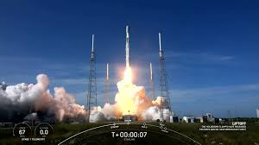
Section 2: Insights drawn from EDA

Slide 16
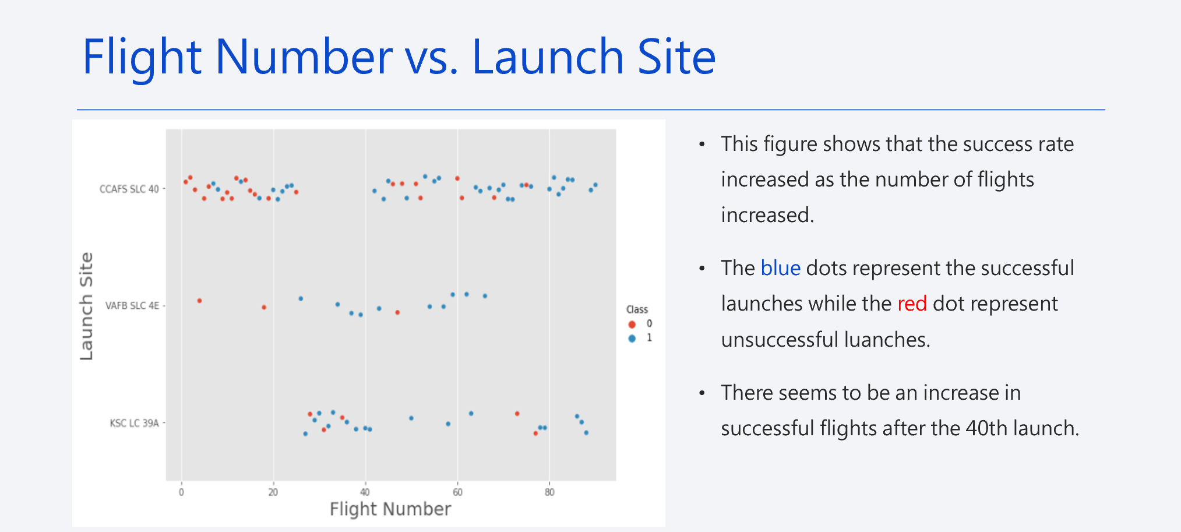

Slide 17
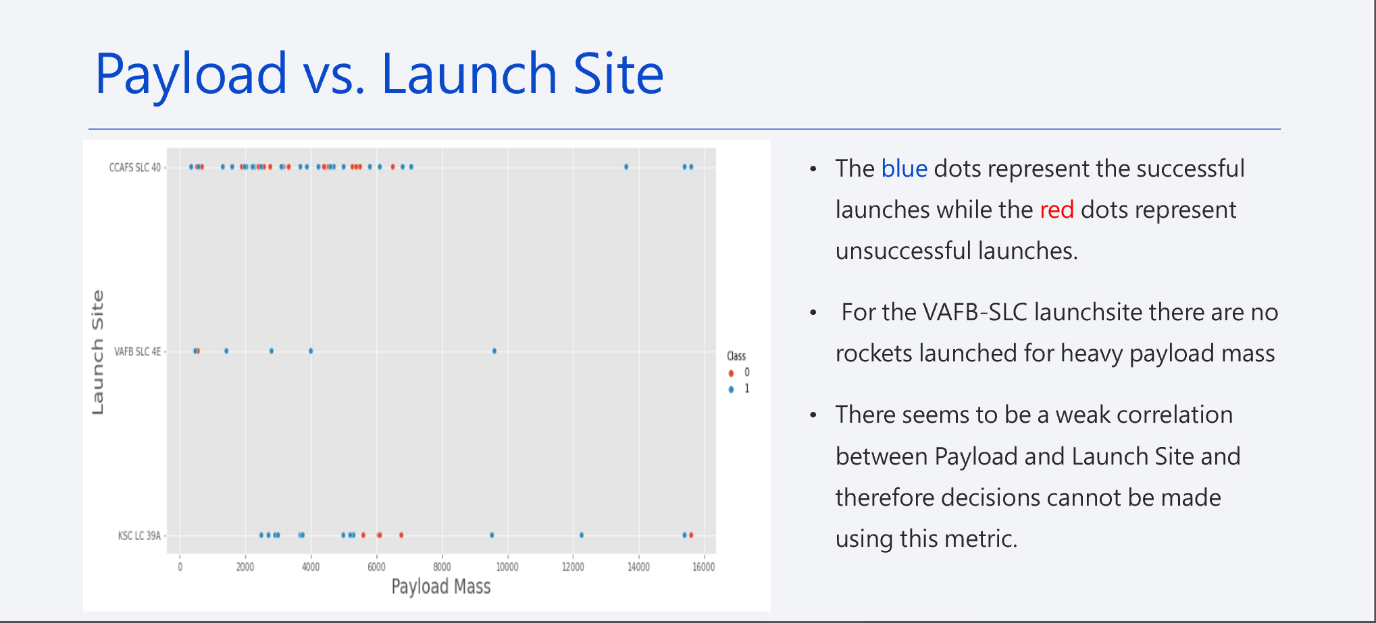

Slide 18
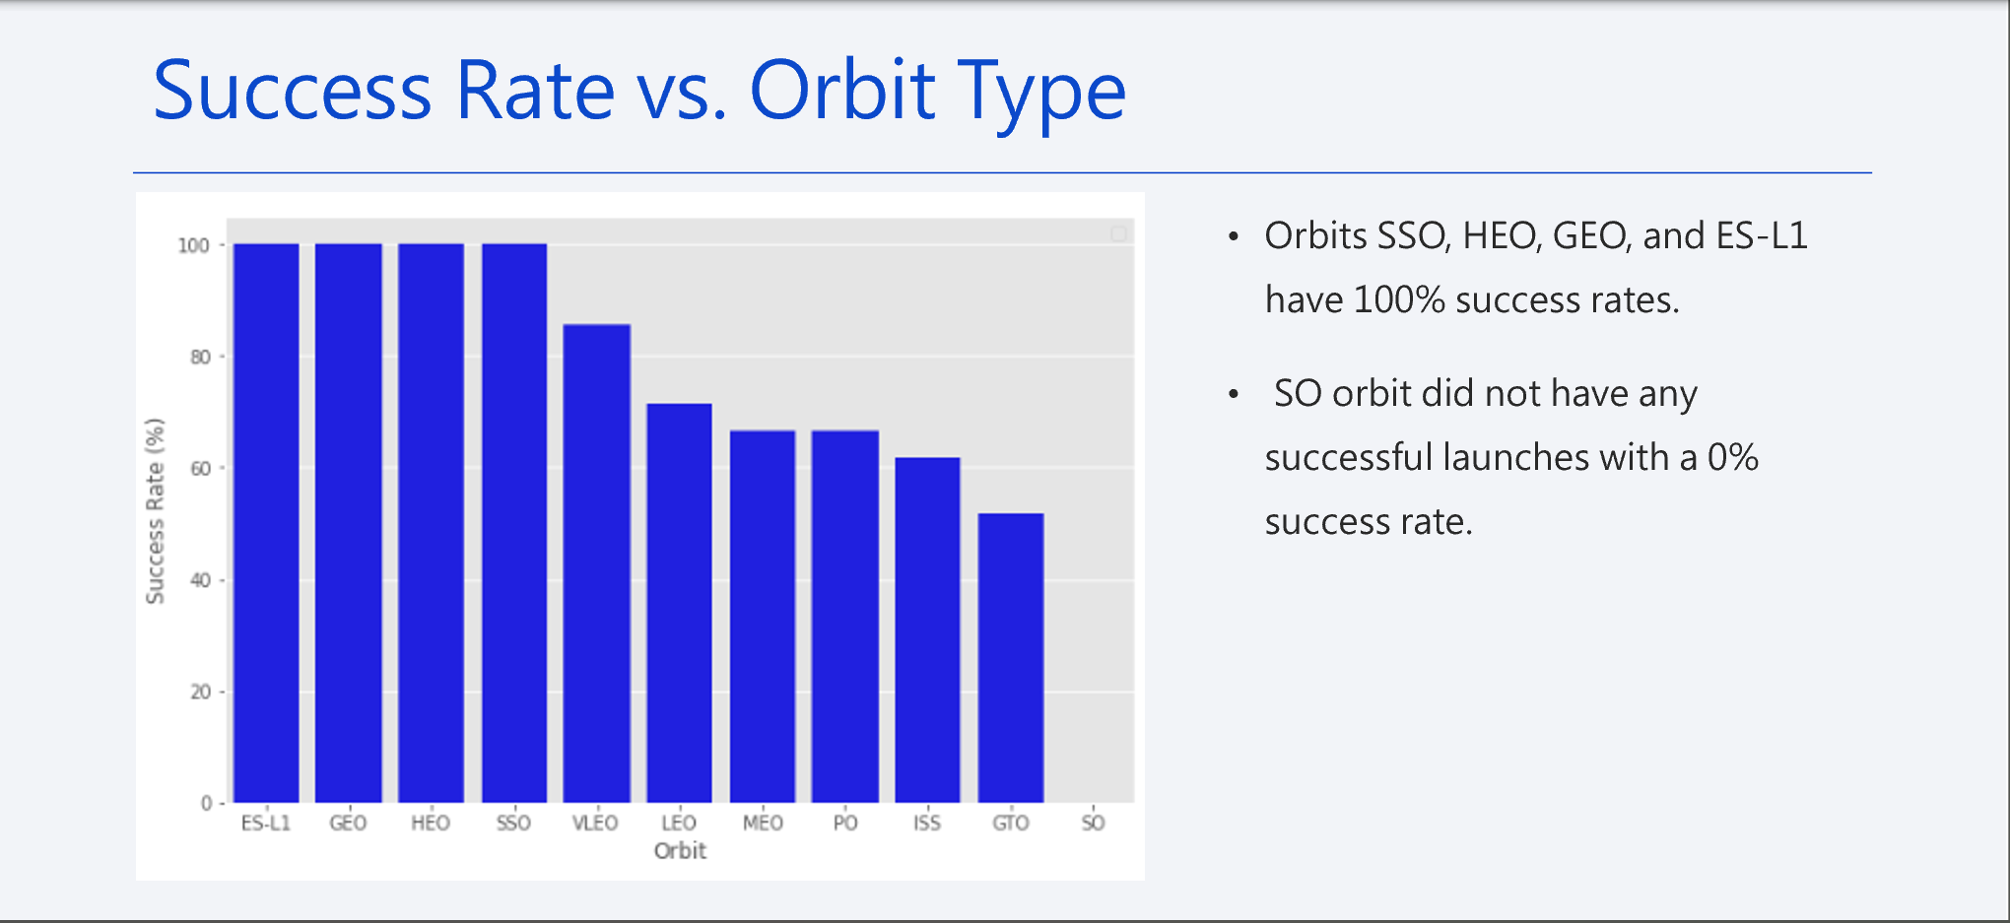

Slide 19
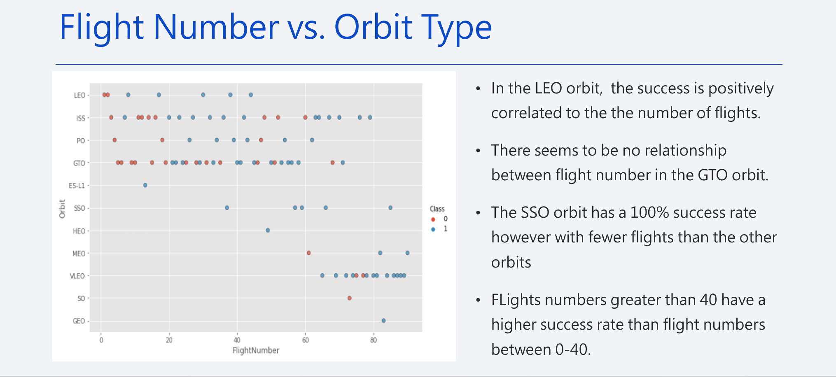

Slide 20
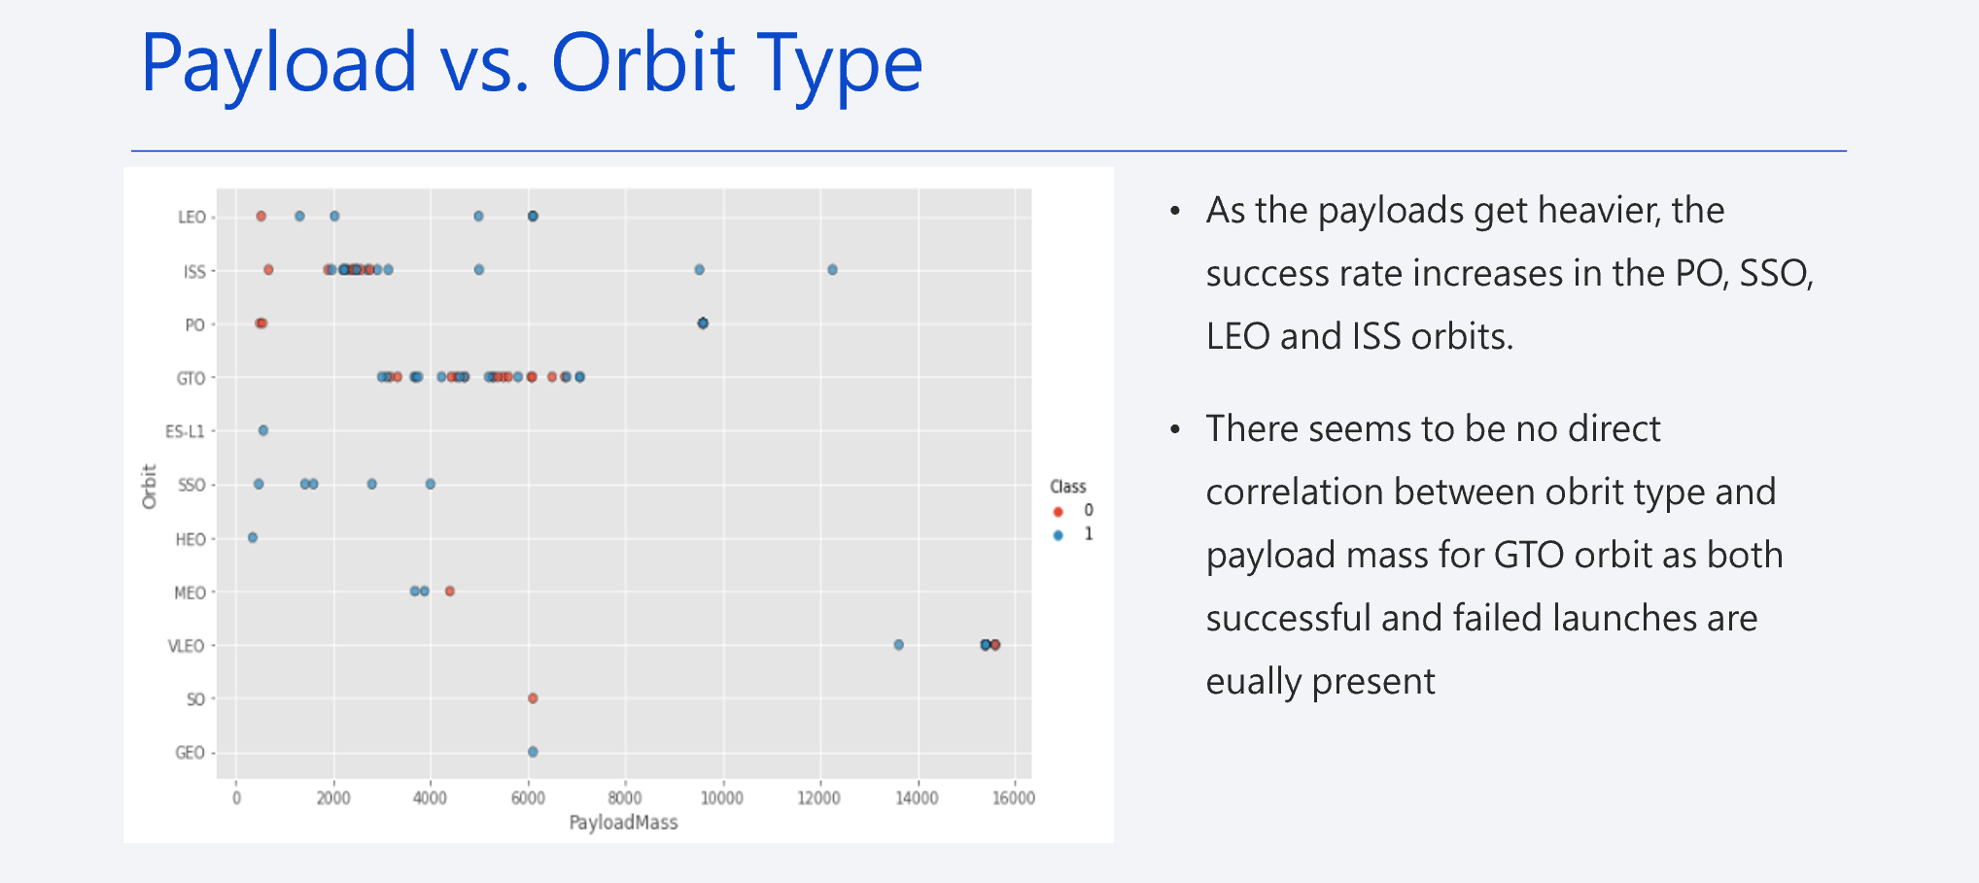

Slide 21
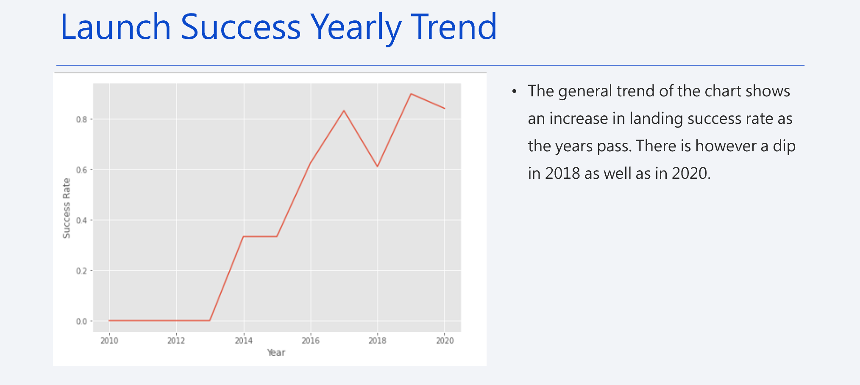

Slide 22
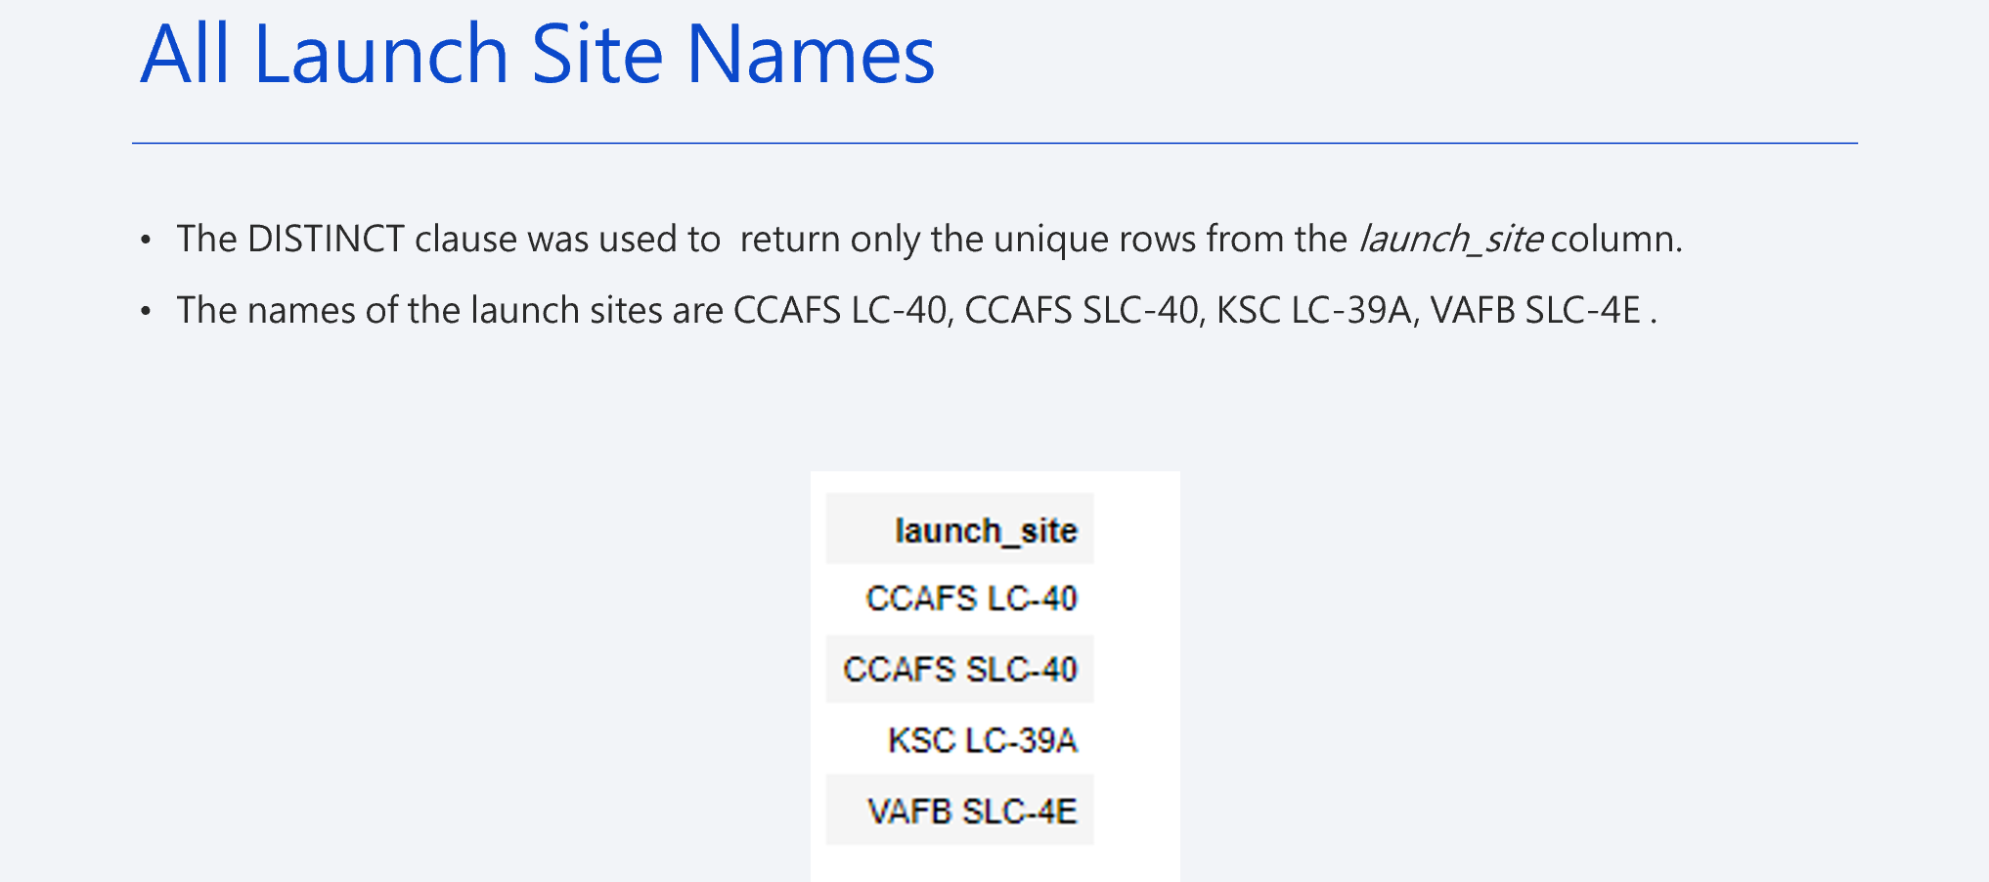

Slide 23
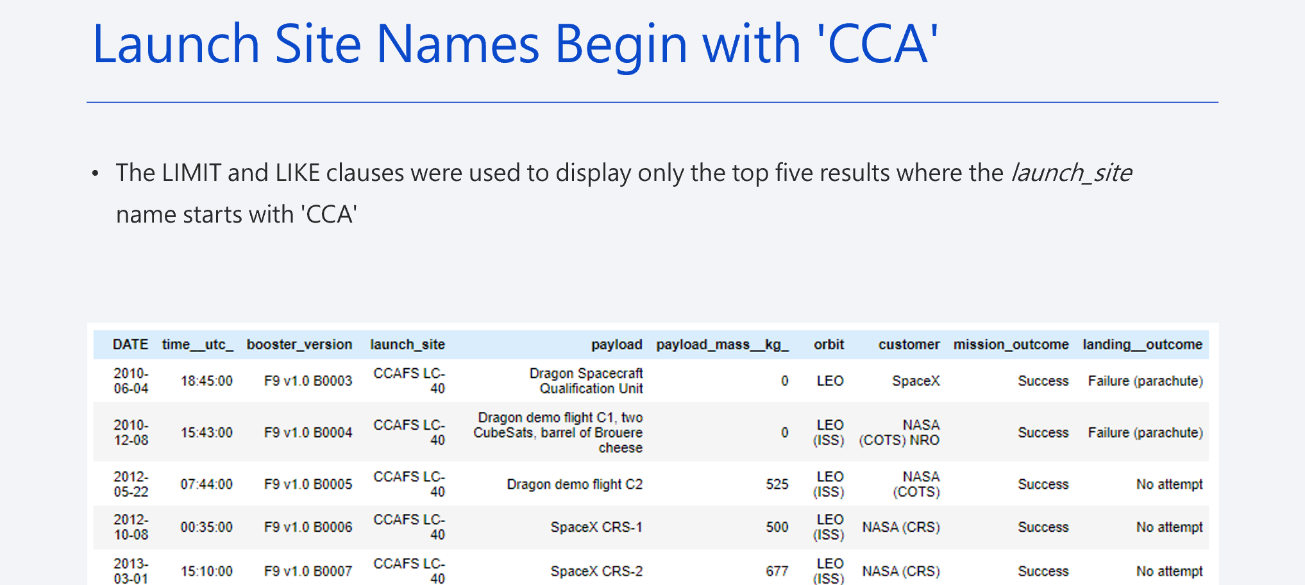

Slide 24
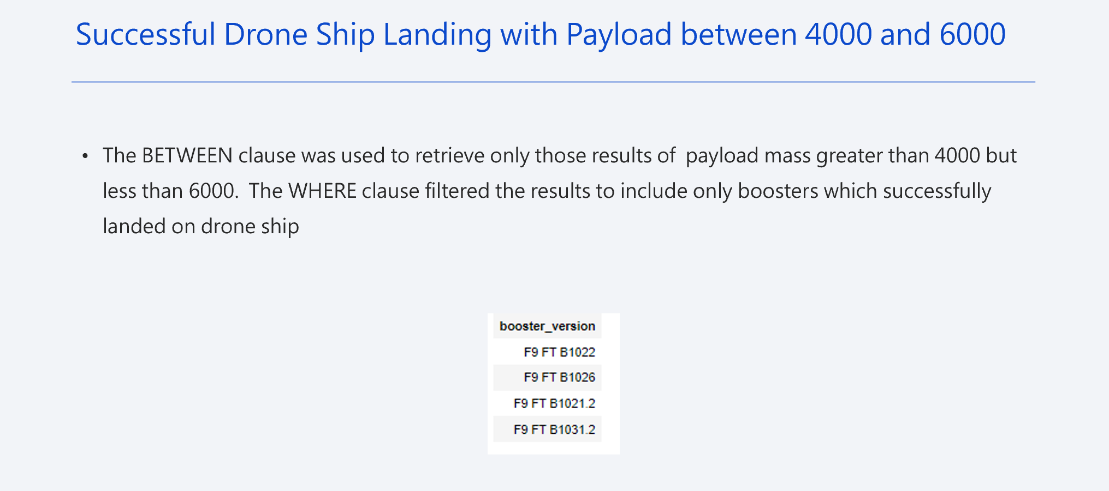

Slide 25
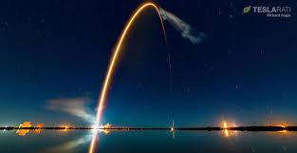
Section 3:
Launch Sites and Proximity Analysis

Slide 26
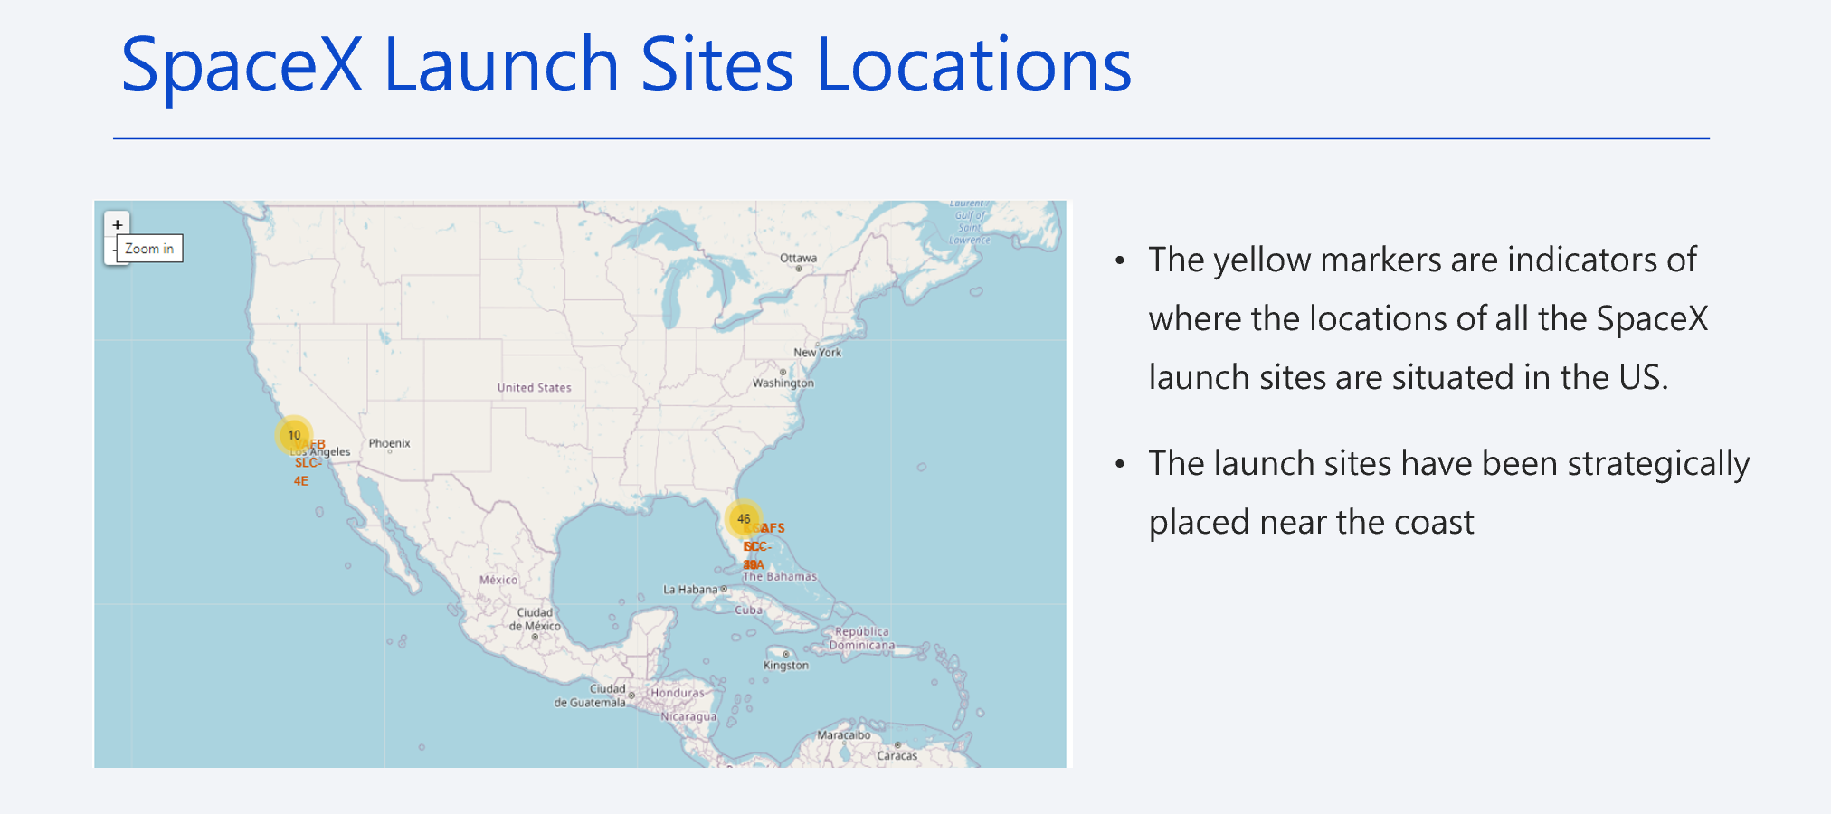

Slide 27
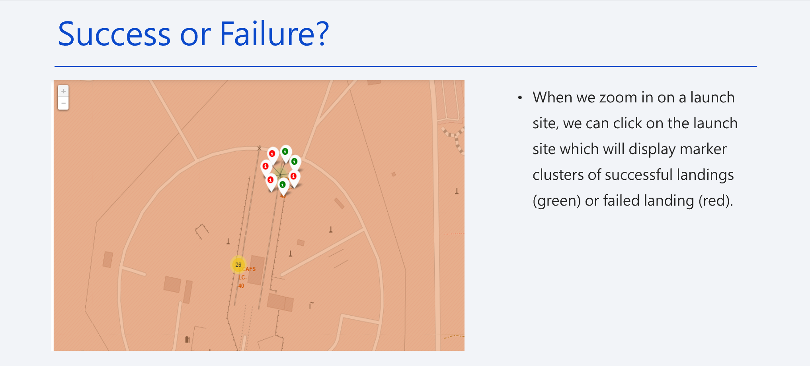

Slide 28
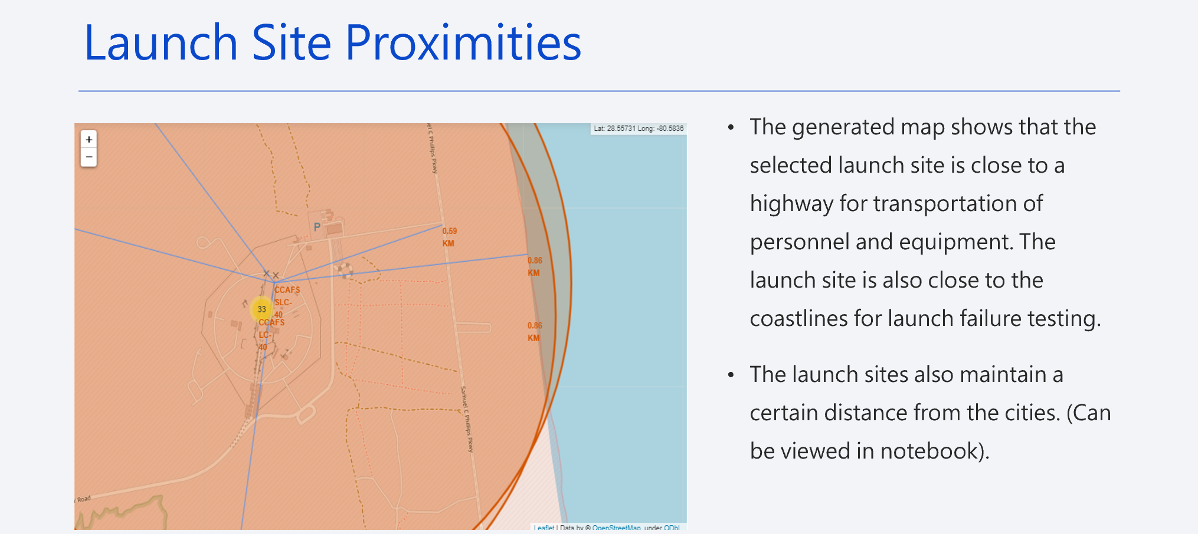

Slide 29
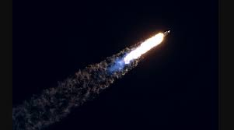
Section 4:
Build a Dashboard with Plotly Dash

Slide 30
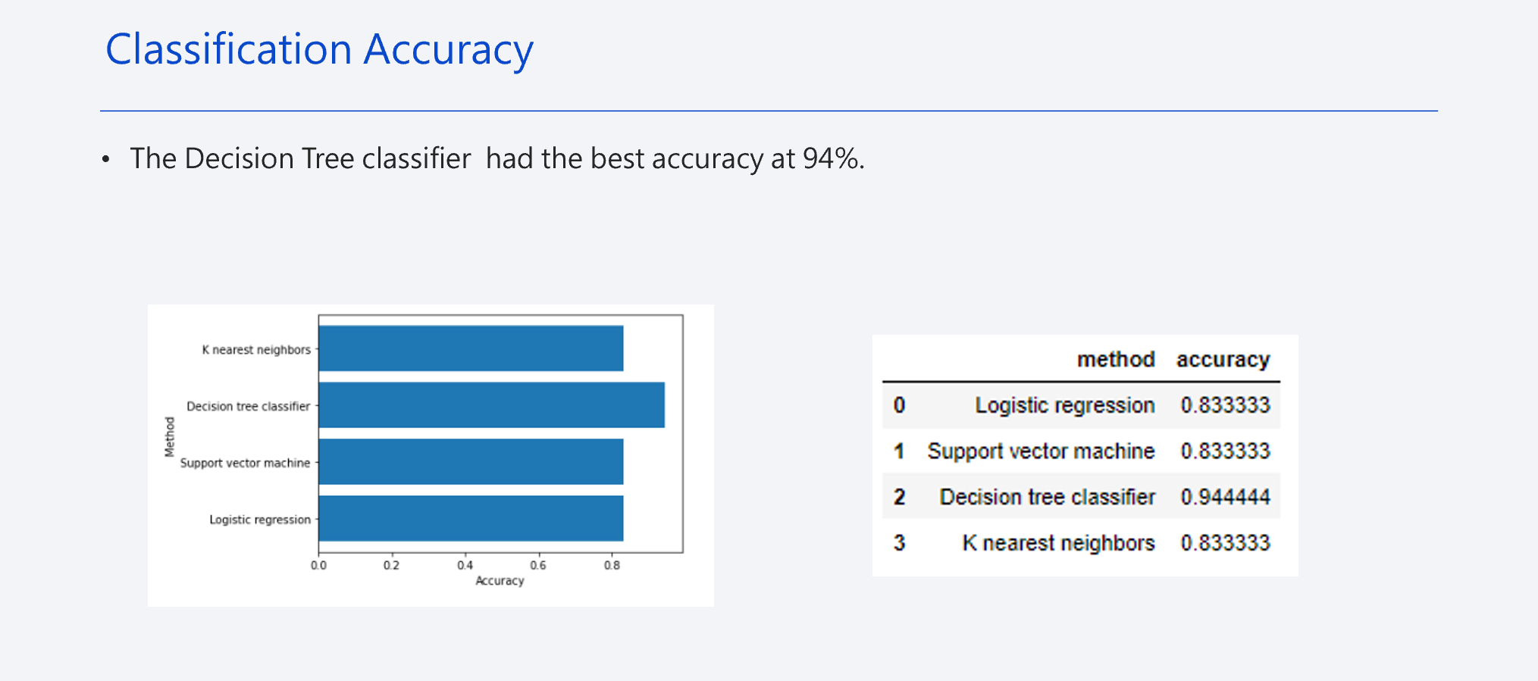

Slide 31
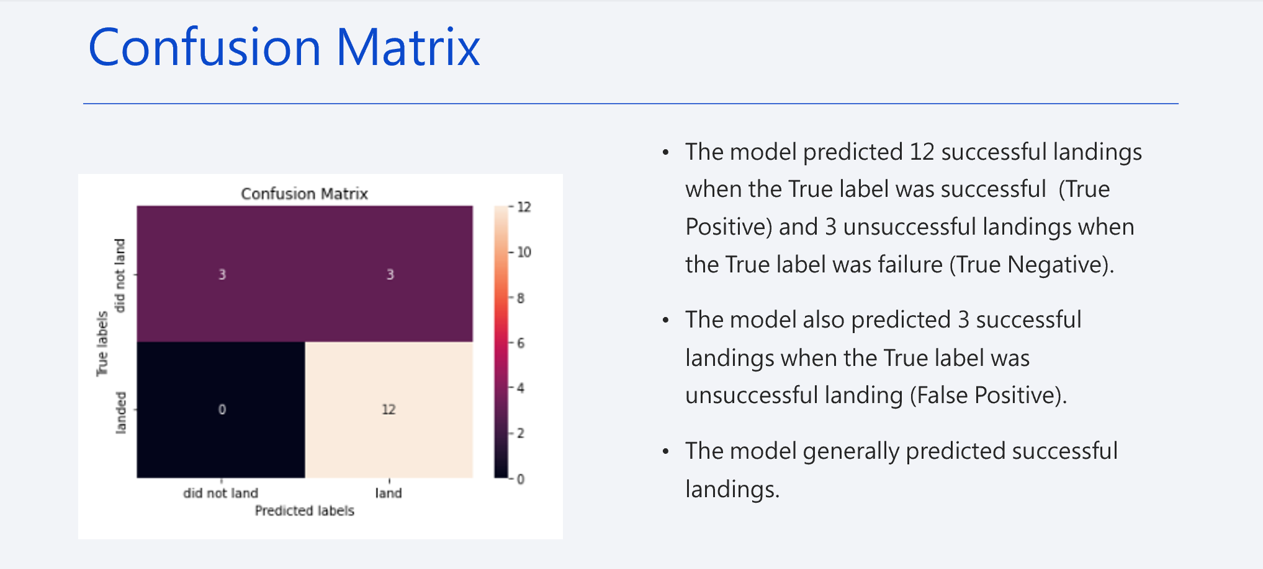

Slide 32
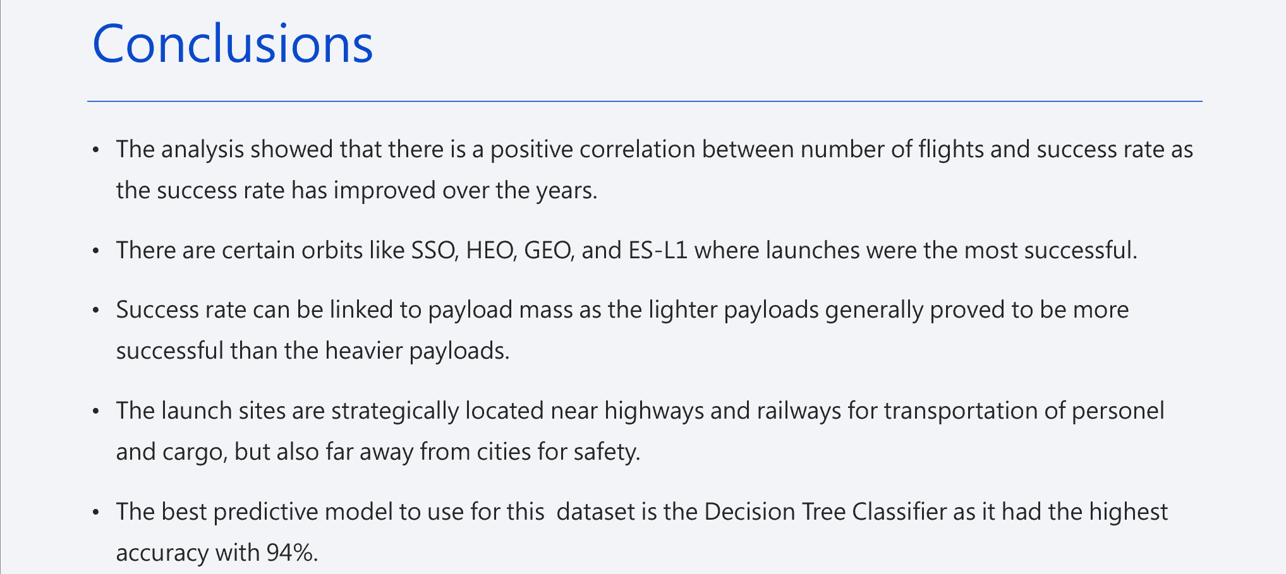

Slide 33
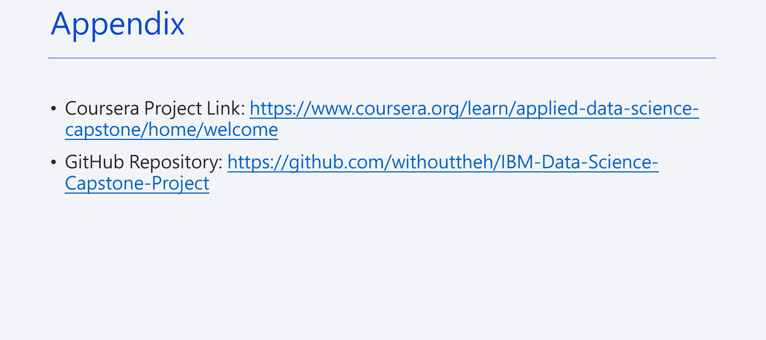

Slide 34
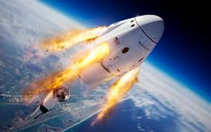
Thank you !

